Slide 1
Welcome to Engagement Management (Add-On)
Professional Services Group

Slide 2
Welcome to RealPage!
RealPage is a leading global provider of AI-enabled software platforms for the real estate industry, founded in 1998 and headquartered in Richardson, Texas. It offers cloud-based property management software for leasing, operations, and notably, algorithmic rent setting, serving over 24 million rental units worldwide. ​
Our suite of solutions benefits owners and managers of various rental property types, including conventional, affordable, military, student, single-family, senior and vacation housing. We also provide commercial and mixed use property management solutions. We’ve evolved our products from the desktop to the cloud, with many available both online and for mobile devices. Our products manage everything from marketing to pricing and other property operations, such as: Property Management, Sales &Marketing, Applicant Screening, Revenue Management, Spend Management, Utility Management, Renters Insurance, Resident Services, and Contact Center.​

Slide 3
Agenda Overview
1
Introductions
Onboarding Calendar and Training Plan
7
2
General Position Overview
8
Team Review
3
PTO Guidelines
4
Job Schedule & Hours
5
Recurring 1:1
6
Annual and Mid-Year Review Process

Slide 4
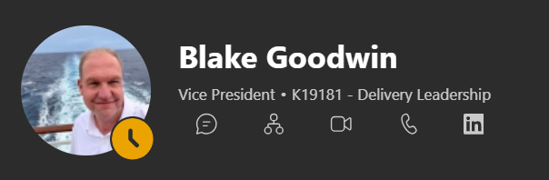
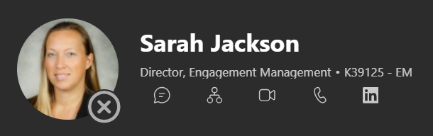
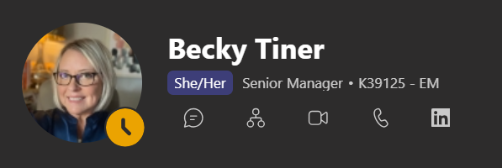
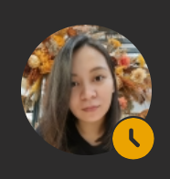
Our Leaders
Blake Goodwin
Sarah Jackson
Becky Tiner
Kat Ragudos
Vice President, Delivery Leadership
Director, Engagement Management
Senior Manager
Team Leader, Engagement Management

Slide 5
Position Overview
Engagement Coordinator Partnership
Providing Coordination, communication and administrative support throughout your implementation journey
Key Responsibilities:
Project Coordination & Administrative Support
  I’ll help coordinate project activities and ensure key tasks are tracked and completed on time.
  I’ll assist with managing documentation, project records, and implementation deliverables.
  I’ll help keep your project organized by monitoring action items and follow-ups.
As Your Scheduling & Logistics Partner
  I’ll coordinate meetings, project calls, and stakeholder communications
  I’ll distribute meeting invitations, agendas, and meeting notes to keep everyone aligned.
  I’ll help manage implementation schedules and support milestone planning activities

Slide 6
Position Overview
Engagement Coordinator Partnership
Providing Coordination, communication and administrative support throughout your implementation journey
Key Responsibilities:
As Your Communication Coordinator
  I’ll serve as a day-to-day point of contact for project-related coordination needs.
  I’ll facilitate communications between your team and the RealPage implementation team.
  I’ll ensure questions, requests, and outstanding items are routed to the appropriate resources for resolution.
As Your Project Support Resource
  I’ll help track project progress and maintain implementation documentation.
  I’ll provide status updates on open tasks, dependencies, and upcoming activities.
  I’ll assist the Engagement manager in ensuring a smooth and successful implementation experience.

Slide 7

Position Overview
Implementation Team
Client
Engagement Coordinator

Slide 8
Expectations with Manager
UPDATE & BE ORGANIZED
  Project Trackers
  Smartsheet Trackers
  EC Action Item Tracker
  EC Lessons Learned
DOCUMENT
  Conversations
  Agenda
  Recap
  Meetings

Slide 9
Expectations with Manager
COMMUNICATE (ASK & RESPOND)
  If it takes more than 5 mins, ask
  Utilize MS Teams chats
  Don’t hesitate to reach out to other teams
  Respond to client emails ASAP (acknowledgement)
RISK MITIGATION
  Possible Escalations/Issues
  Client Sentiment/Temperature
  Implementation Errors
  Upcoming Projects

Slide 10
Expectations with Manager
STAY WITHIN YOUR SWIMLANE
  Help organize but call out if you feel like it is already outside your scope
  Point them to the right direction
  Teach them how to fish
PROBLEM SOLVING MINDSET
  You’re not the Subject Matter Expert but you can help gather the experts to resolve the issue

Slide 11
Expectations with Manager
BE PROACTIVE
  Ask to shadow EMs/ECs
  Share best practices and lessons learned
INNOVATE
TRAINING
  Suggestions to improve processes
  Utilize Lumina, Co-Pilot and other AI Tools
  Attend trainings even those not specific for EMs/ECs (Winzday, SC Milestones etc)

Slide 12
Expectations with Manager
BE CREATIVE BUT FOLLOW STRUCTURE AND TIMELINES
  Find your style but follow our set guidelines
  Set proper expectations with clients (timelines)
ACCOUNTABILITY
  You are bound to make mistakes
  Own up, focus on what you’ve learned and next steps

Slide 13


Business Hours
  9PM - 6AM / 10PM - 7AM​ (DST)
​
  Onboarding - 2 Weeks​
​
  Shadowing - 2 or more projects​
​
  WIO - Mon – Wed (3 months*)

Slide 14

Work From Home
Be Productive (Integrity)
Team Meetings​
  Listen​
  Participate​
  Ask Questions​
​
Client Meetings​
  Record​
  Be Warm and Friendly but keep it Polite and Professional​
  Turn on Camera (Be Presentable)​
  Agenda 24 hrs before meeting​
  Recap within 24 hrs after meeting

Slide 15

PTO Guidelines
  EM PTO Request Form and Calendar​
  PH PSG PTO Process ​
  OOO Buddy/Endorsements​
  Calendar and Auto-Replies​
  Client and SC Notifications​
  Dayforce

Slide 16
Coaching & Team Meetings
  Weekly / Bi-weekly 1:1​
  Discuss Projects​
  Raise Questions​
  Share Observations/Clarifications (Shadowing)​
  Weekly Project Update (Email)​
  Annual & Mid-Year Performance Review​
  Bi-Weekly EM Meetings (Mondays 10AM CT)​
  Bi-Weekly Cluster Meetings (Wednesdays* 10 AM CT)​
  PH EC Connect (TBD)​

Slide 17

Onboarding Calendar
Teams Review

Slide 18

Any Questions?
As we conclude your onboarding, we want to address any remaining questions you may have. This is your chance to seek clarification on any aspect of your role, company culture, or about our company. Your questions are valuable, and we're here to ensure you feel confident and well-informed. Let's make sure you're ready for the exciting journey ahead.

Slide 19
Thank you!
Engagement Management
Professional Services Group

